Slide 1
Kernel Methods and Support Vector Machines
CSCI 4360/6360 Data Science II

Slide 2
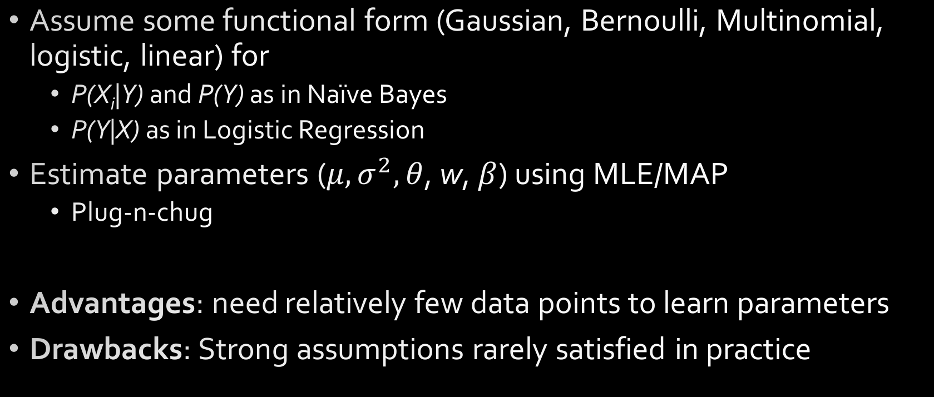
Parametric Statistics
Assume some functional form (Gaussian, Bernoulli, Multinomial, logistic, linear) for
P(X_{i}|Y) and P(Y) as in Naïve Bayes
P(Y|X) as in Logistic Regression
Estimate parameters ($μ,σ^{2},θ$, w, $β$) using MLE/MAP
Plug-n-chug
Advantages: need relatively few data points to learn parameters
Drawbacks: Strong assumptions rarely satisfied in practice

Slide 3
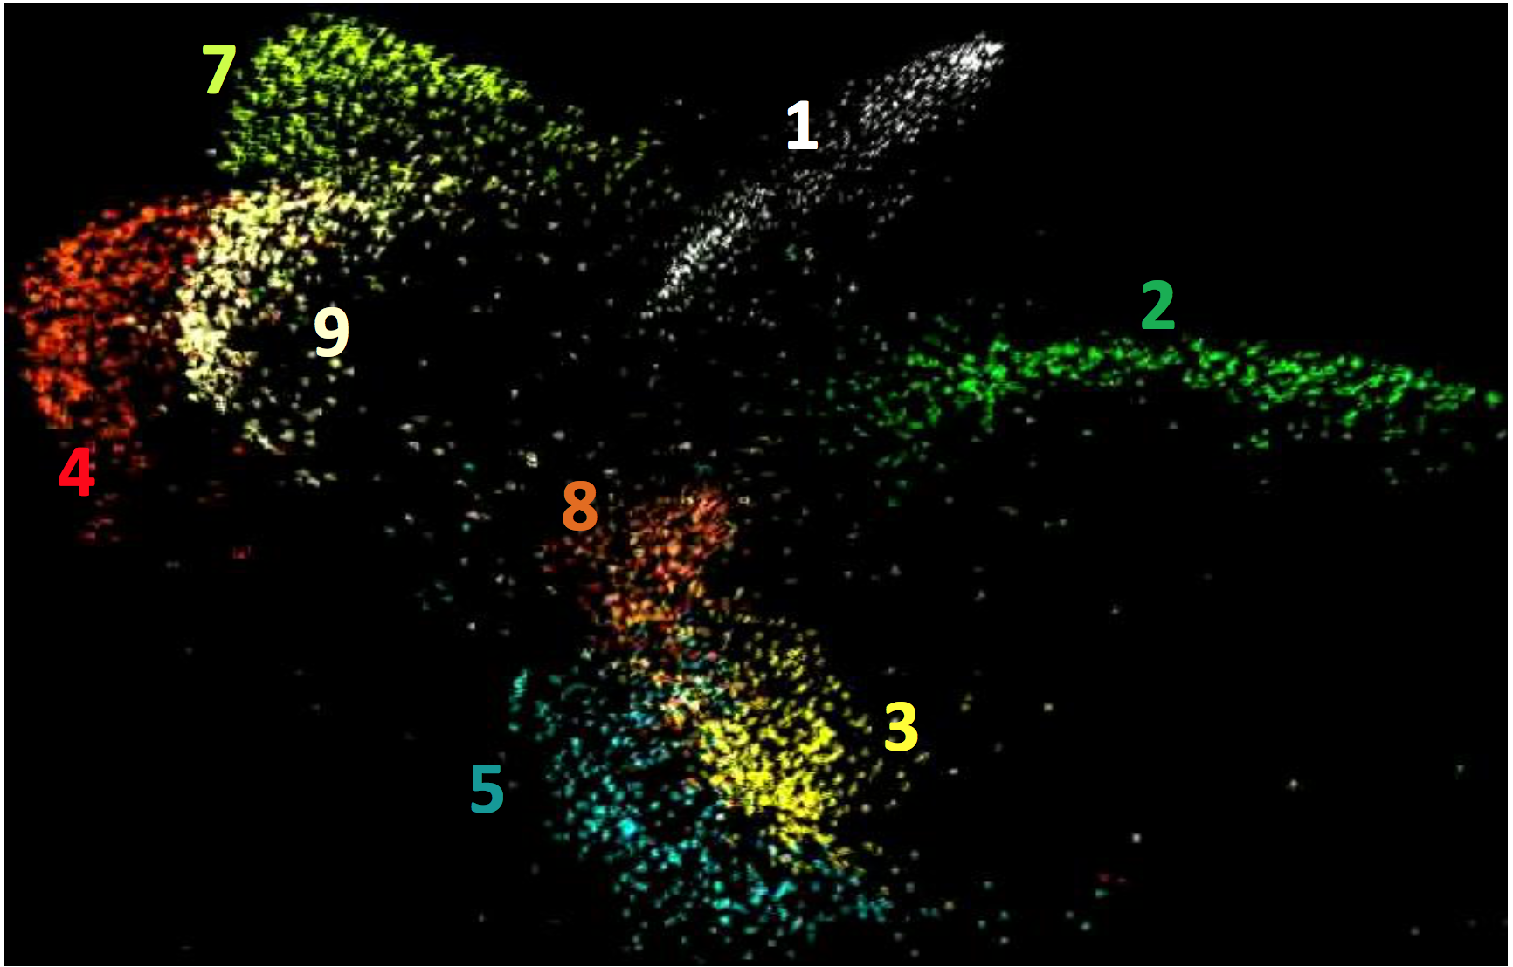
Embeddings
Again!
MNIST, projected into 2D embedding space
What distribution do these follow?
Highly nonlinear

Slide 4
Nonparametric Statistics
Typically very few, if any, distributional assumptions
Usually requires more data
Let number of parameters scale with the data
Today
Kernel density estimation
K-nearest neighbors classification
Kernel regression
Support Vector Machines (SVMs) → not exactly nonparametric, but kernels are involved!
Notes:
Even nonparametric logistic regression!

Slide 5
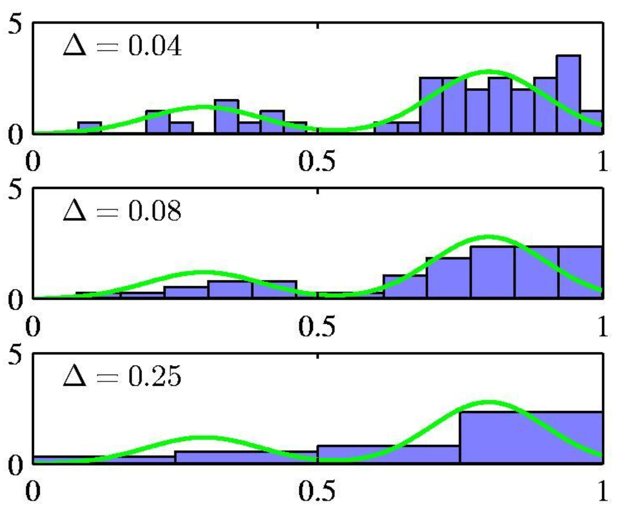
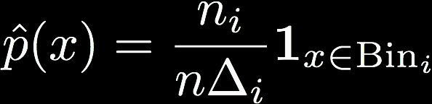
Density Estimation
You’ve done this before—histograms!
Partition feature space into distinct bins with specified widths and count number of observations n_{i} in each bin
Same width is often used for all bins
Bin width acts as smoothing parameter

Slide 6
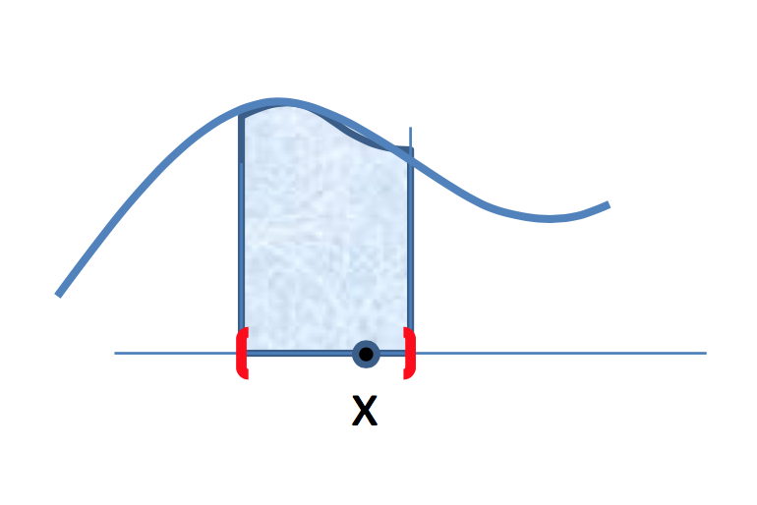
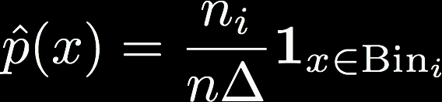
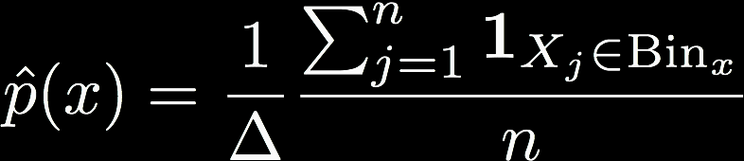
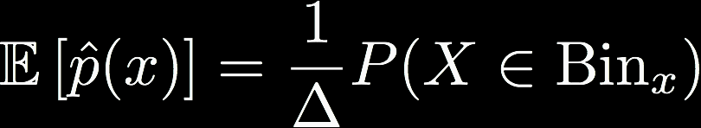


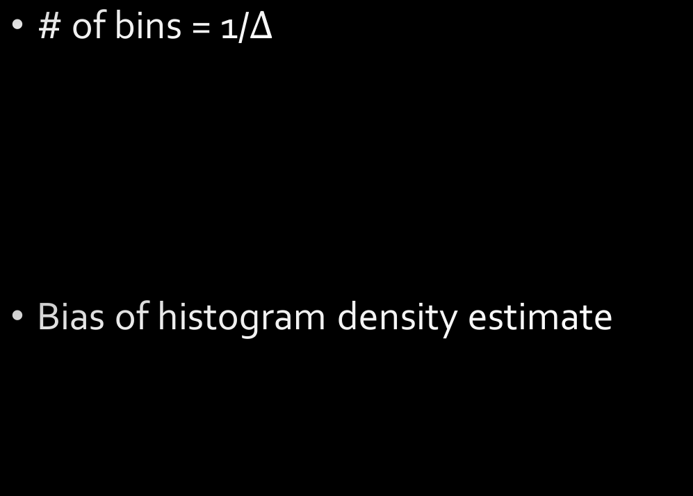
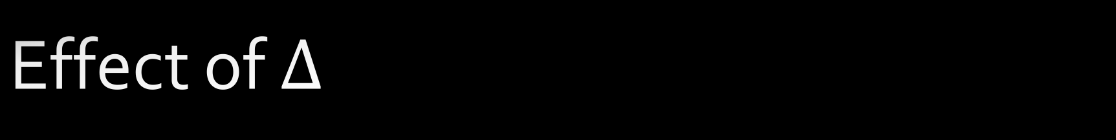
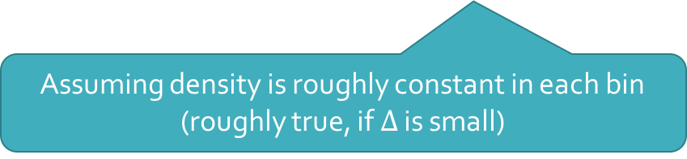
Effect of $Δ$
# of bins = 1/$Δ$
Bias of histogram density estimate
Assuming density is roughly constant in each bin (roughly true, if $Δ$ is small)

Slide 7


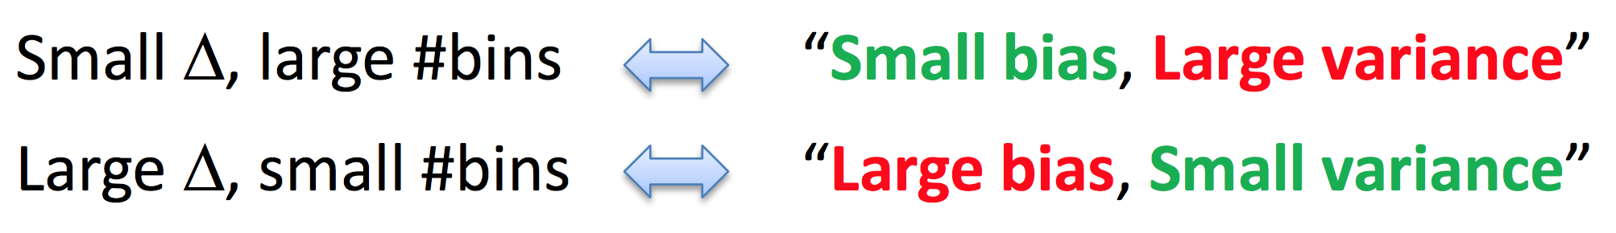
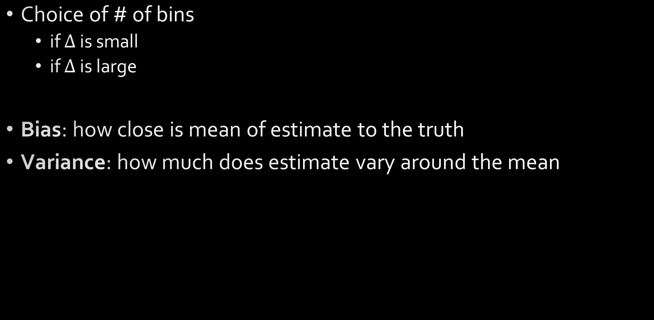
Bias-Variance Trade-off
p(x) approximately constant per bin
Choice of # of bins
if $Δ$ is small
if $Δ$ is large
Bias: how close is mean of estimate to the truth
Variance: how much does estimate vary around the mean
More data per bin stabilizes estimate

Slide 8
Bias-Variance Trade-off

Slide 9
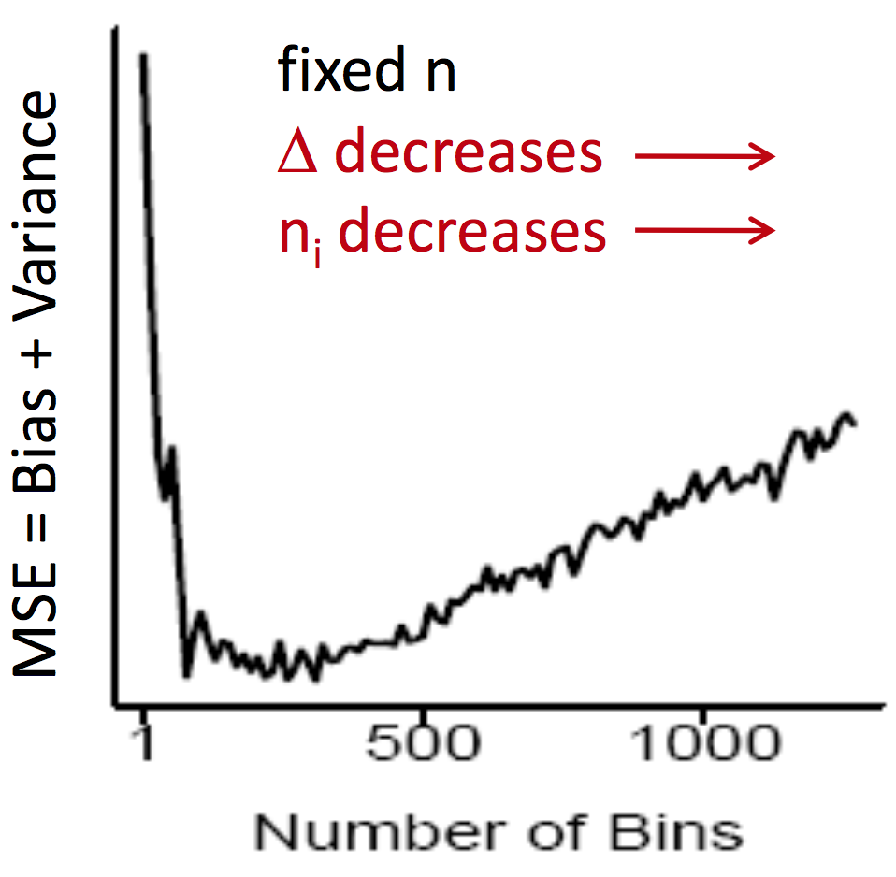
Choice of number of bins

Slide 10
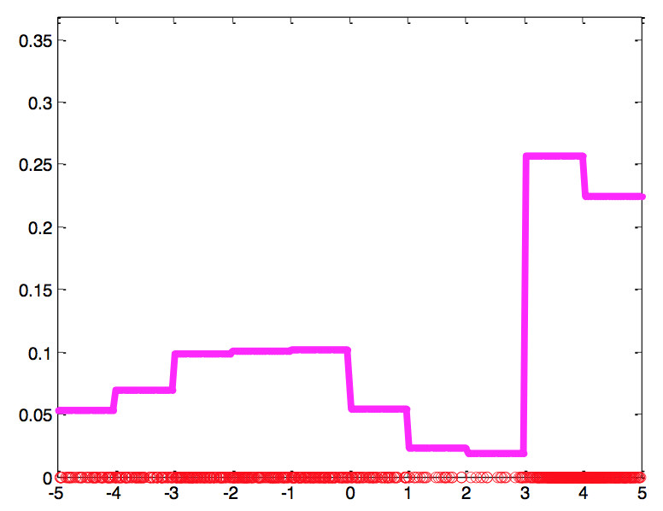
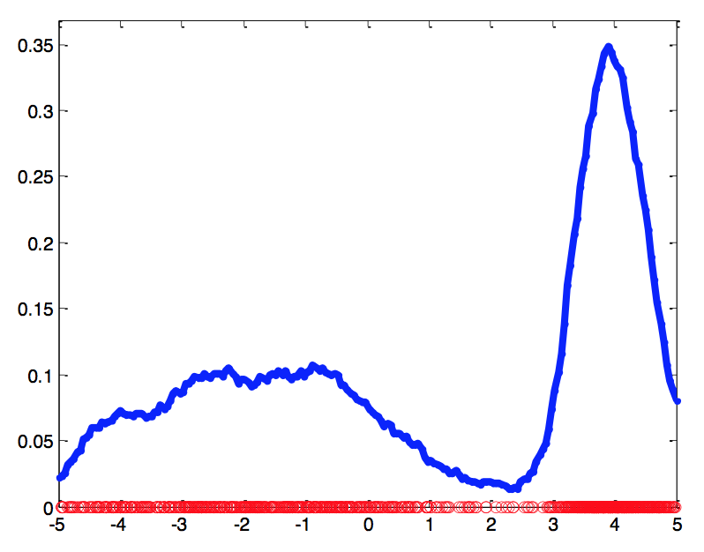
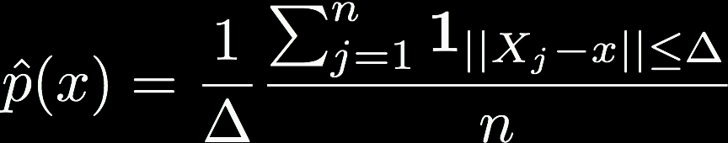
Kernel Density Estimation
Histograms are “blocky” estimates
Kernel density estimate, aka “Parzen / moving window” method

Slide 11
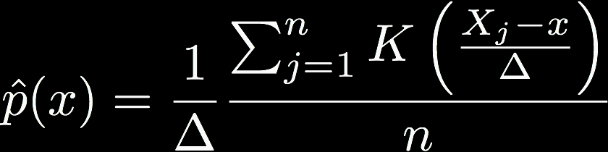
Kernel Density Estimation
More generally:
K is the kernel function
Much like kernels in Kernel PCA or SVMs: model a relationship between two data points
Embodies any number of possible kernel functions

Slide 12
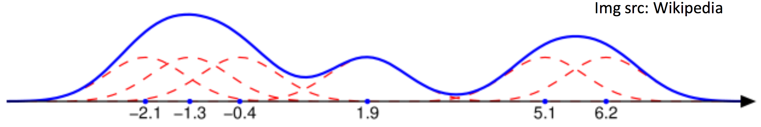
Kernel Density Estimation
Places small “bumps” at each data point, determined by K
Estimator itself consists of a [normalized] “sum of bumps”
Where points are denser, density estimate will be higher
Notes:
Gaussian bumps (red) around six data points (blue dots)—they sum to the blue curve

Slide 13
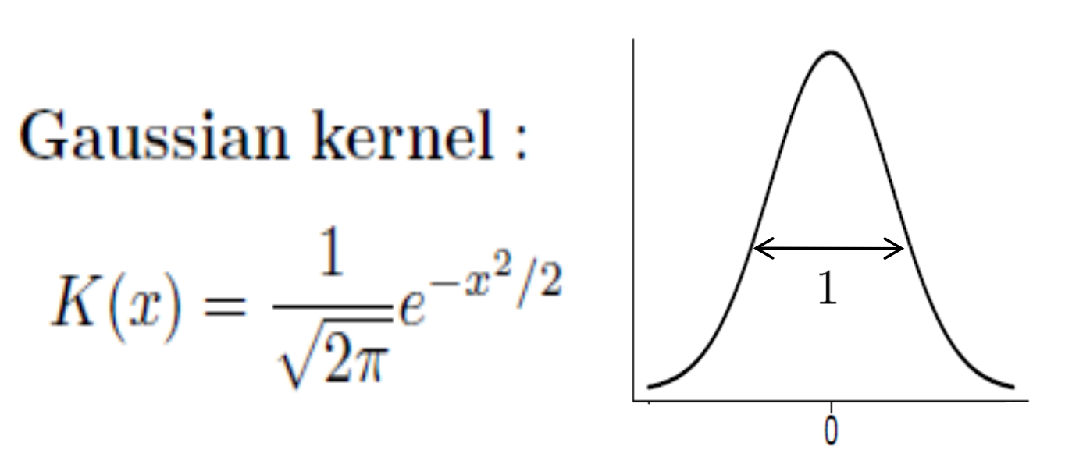
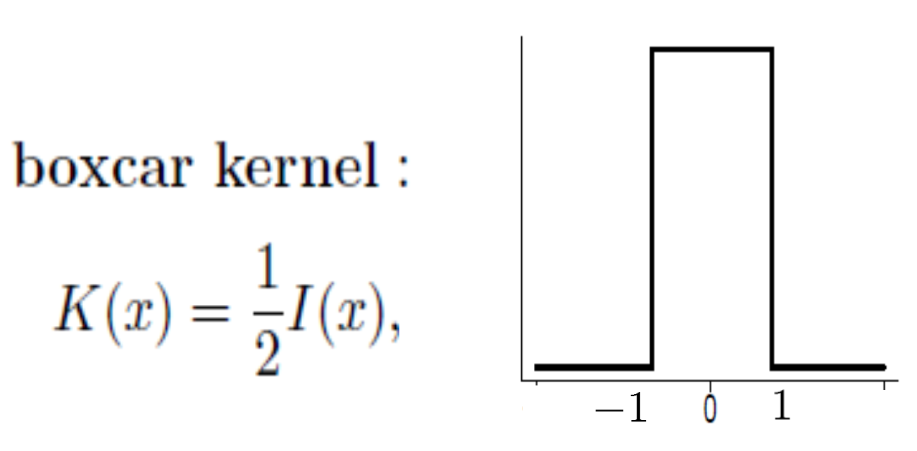
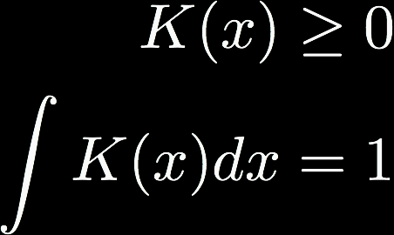
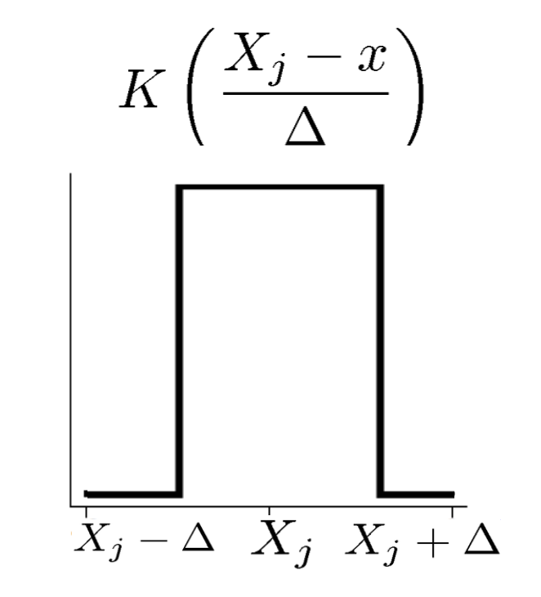
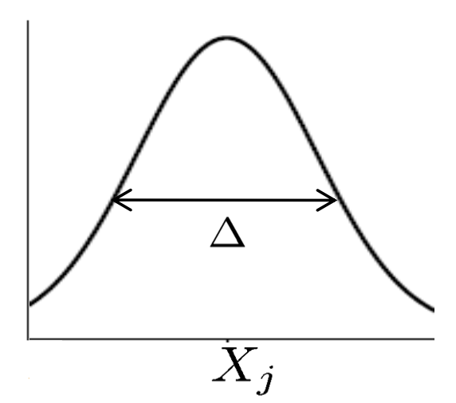
Kernels
Any function that satisfies
SciPy has a ton
See “signal.get_window”
Infinite support: need all points to compute estimate. But quite popular.
Finite support: only need local points to compute estimate

Slide 14
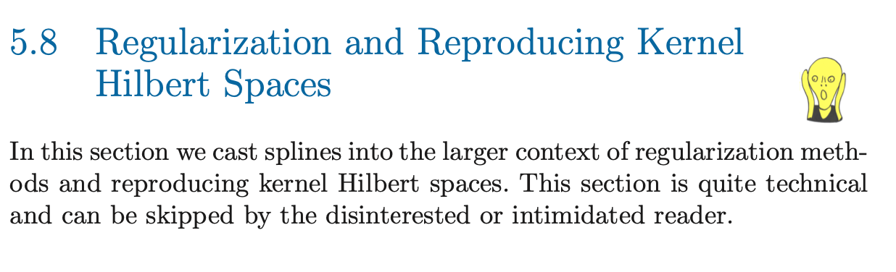
Kernels
Deep theory associated with kernels and kernel functions
Touched on in Kernel PCA lecture
Foundational to Support Vector Machines and Deep Neural Networks
Elements of Statistical Learning, Chpt. 5

Slide 15
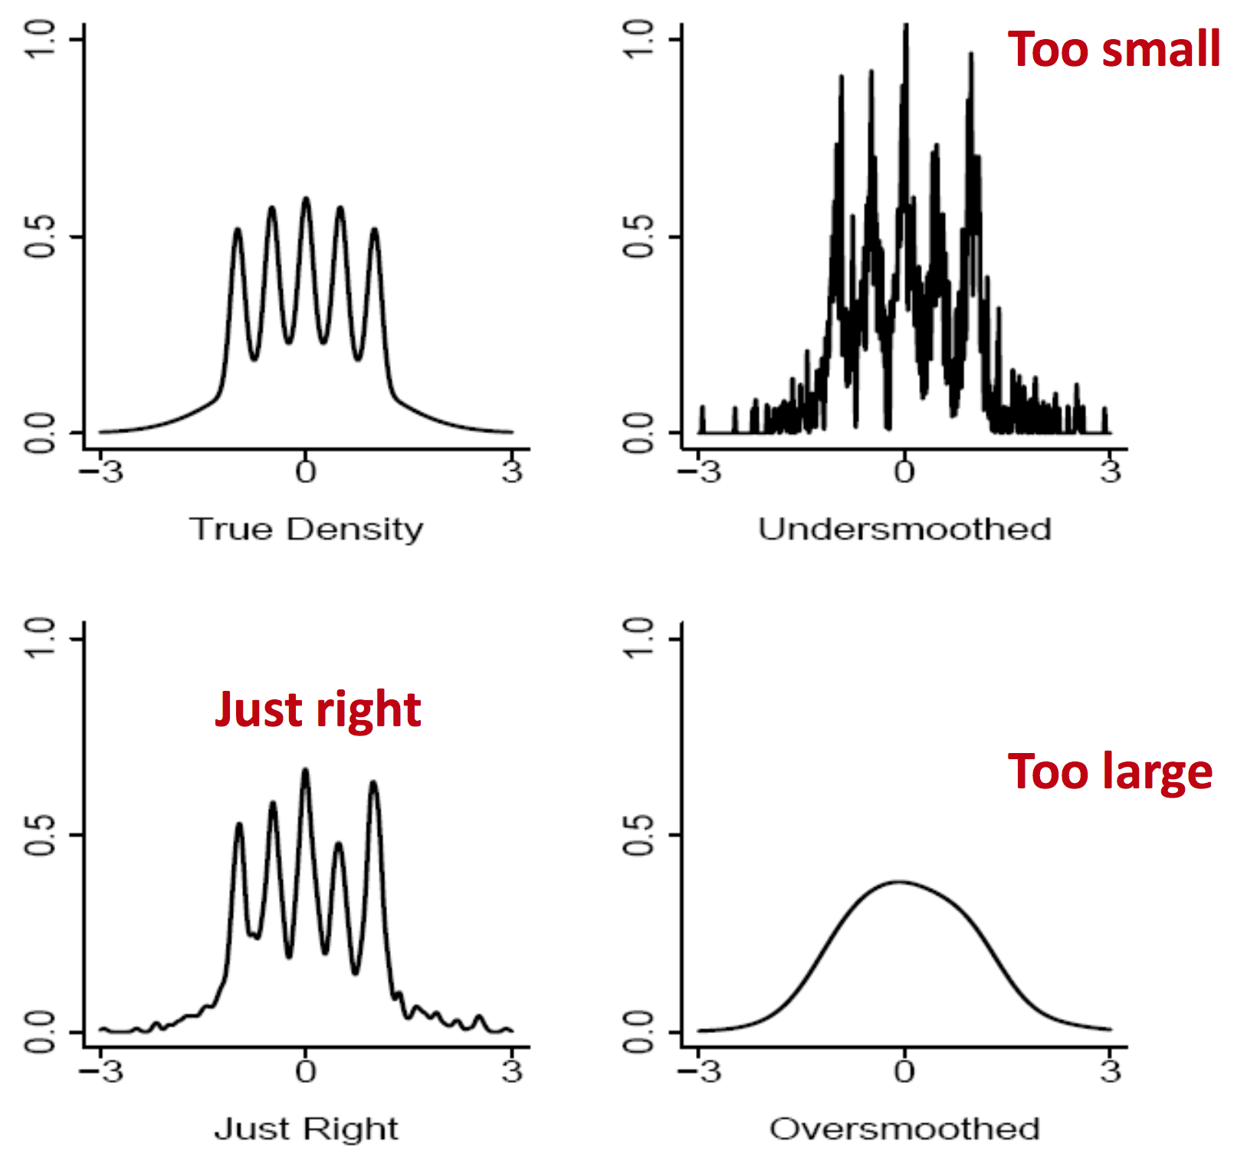
Choice of kernel bandwidth
The Bart-Simpson Density

Slide 16
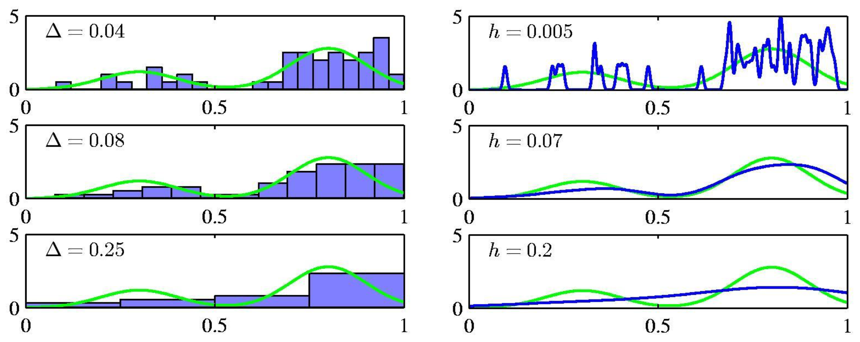
Histograms versus KDE

Slide 17
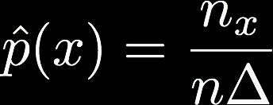
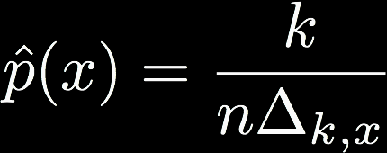
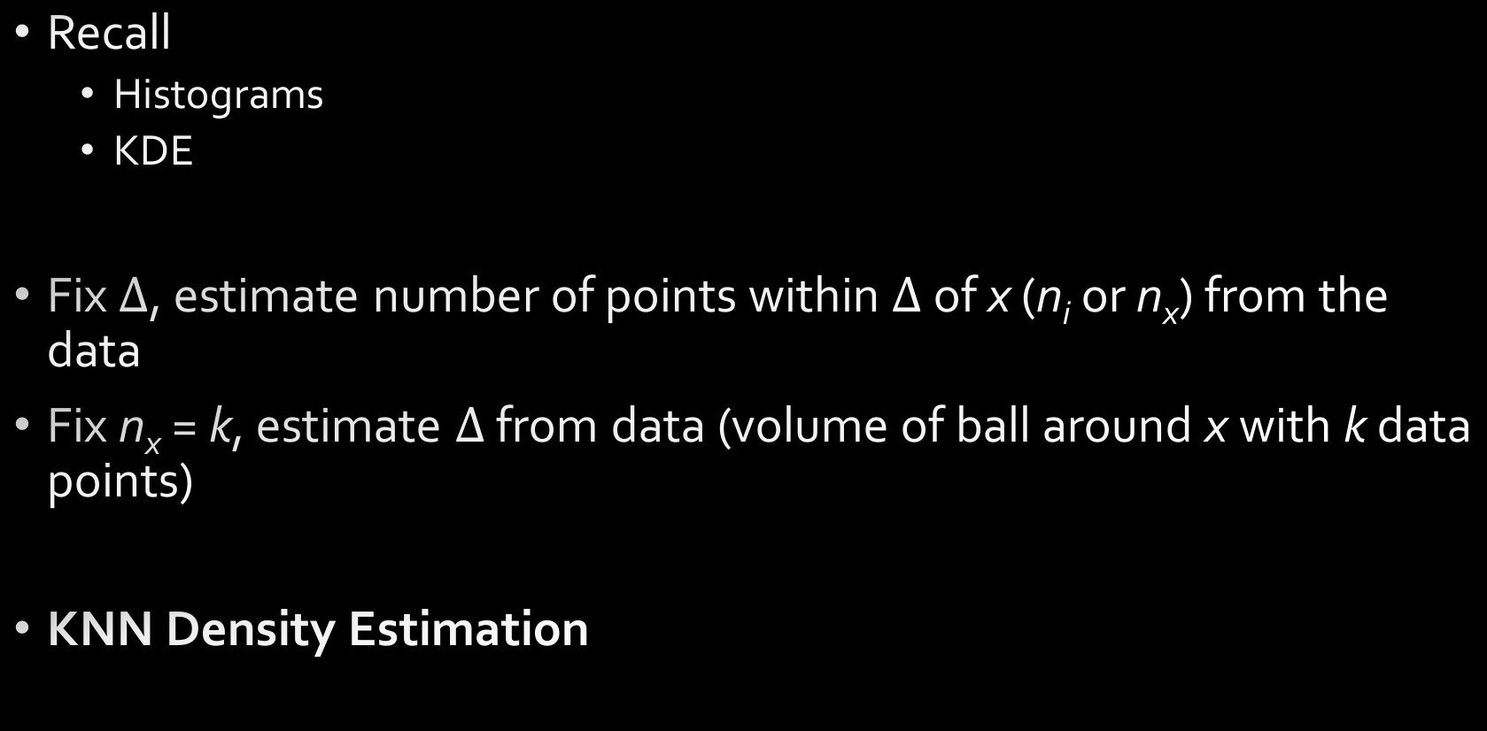
KNN Density Estimation
Recall
Histograms
KDE
Fix $Δ$, estimate number of points within $Δ$ of x (n_{i} or n_{x}) from the data
Fix n_{x} = k, estimate $Δ$ from data (volume of ball around x with k data points)
KNN Density Estimation

Slide 18
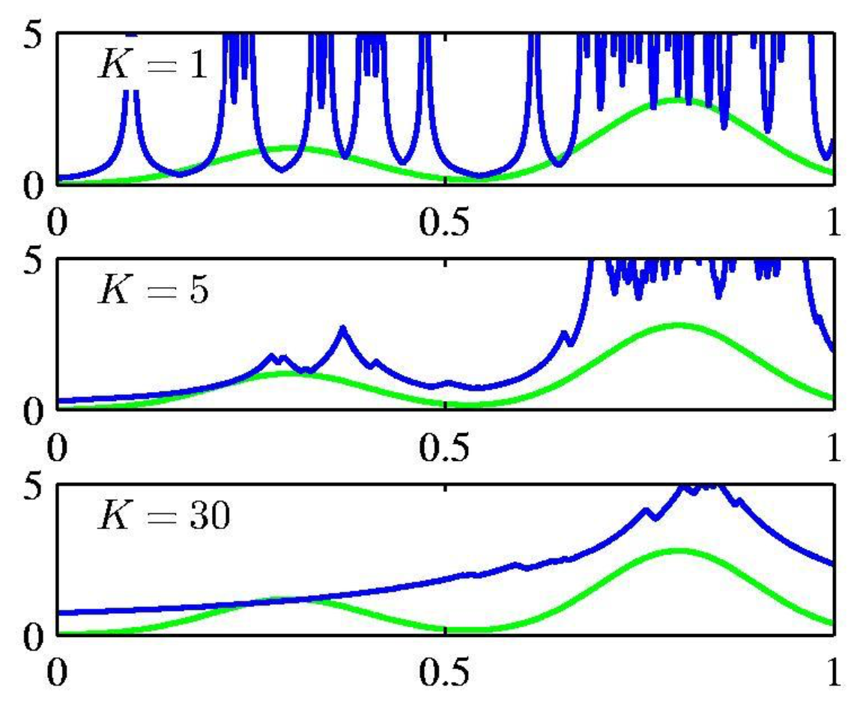
KNN Density Estimation
k acts as a smoother
Not very popular for density estimation
Computationally expensive
Estimates are poor
But related version for classification is very popular

Slide 19
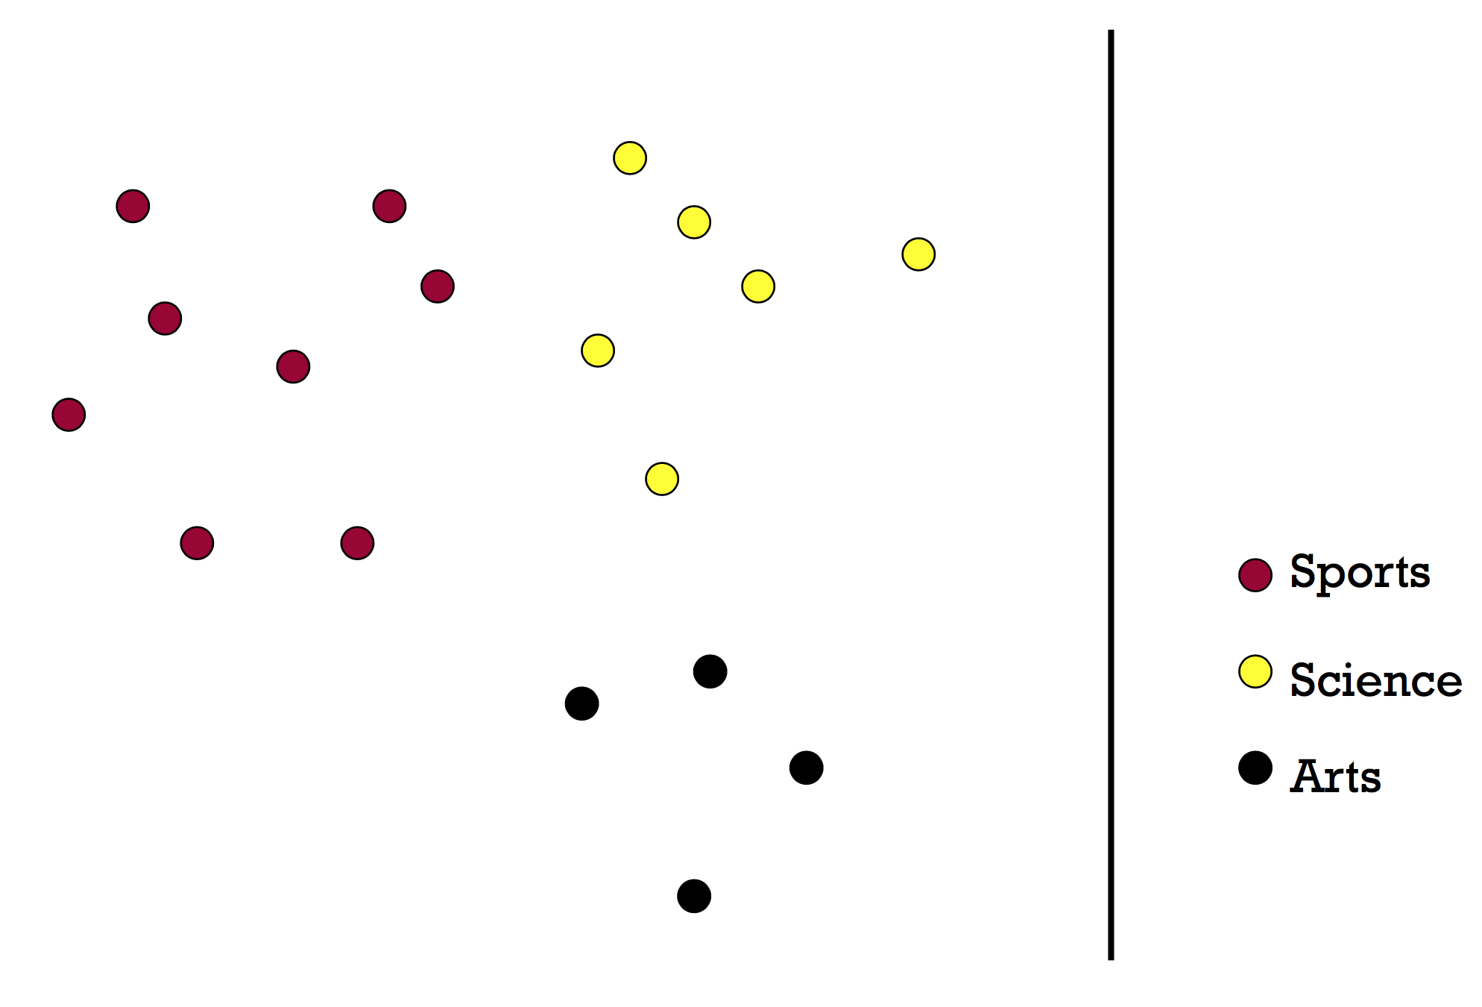
KNN Classification

Slide 20
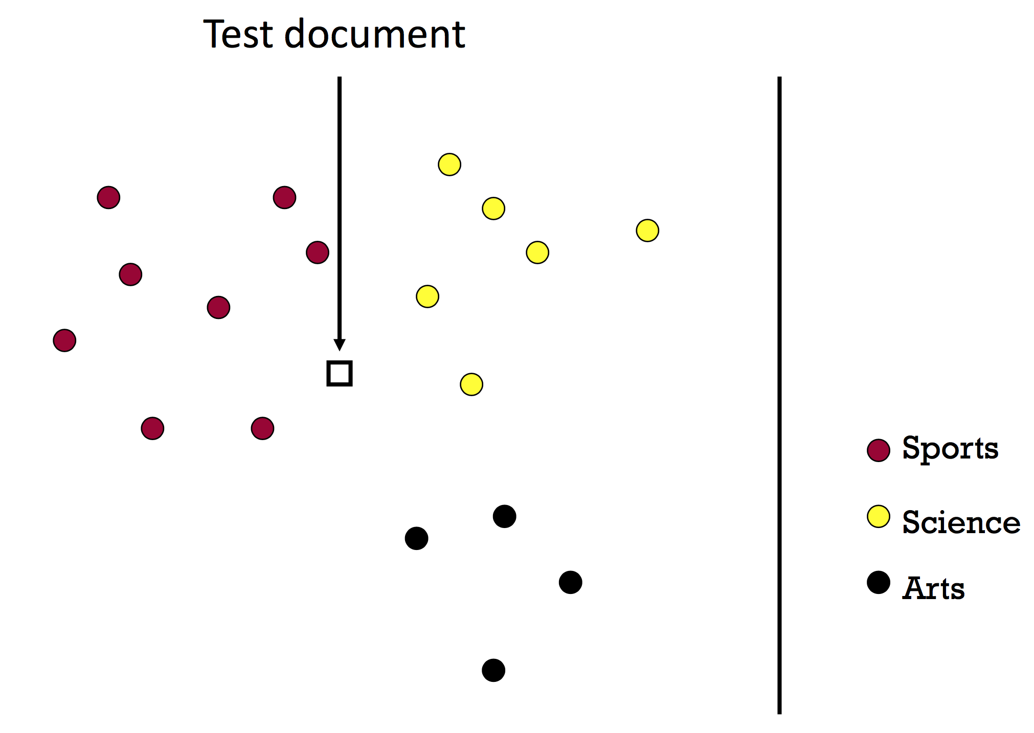
KNN Classification

Slide 21
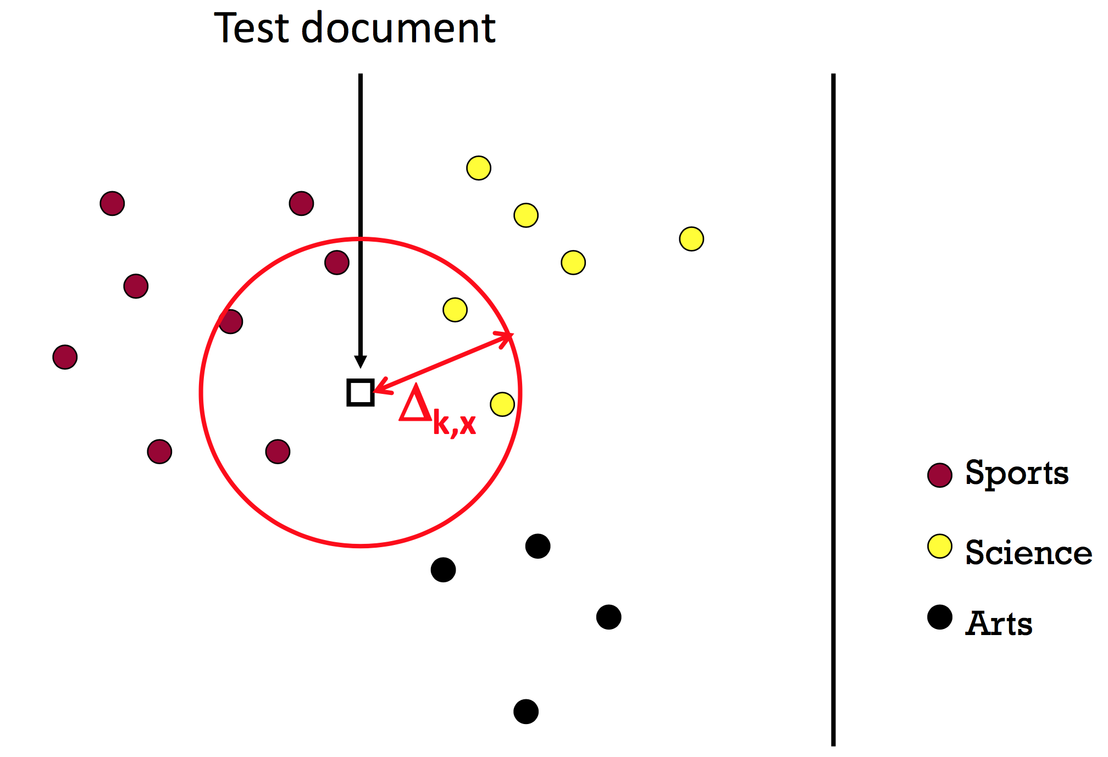
KNN Classification
k = 4
What should we predict?
Average? Majority? Why?

Slide 22
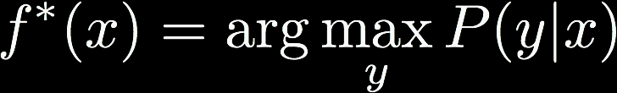
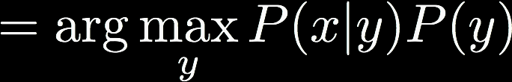
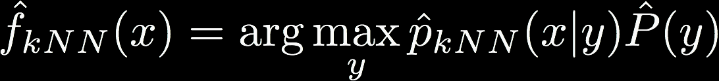

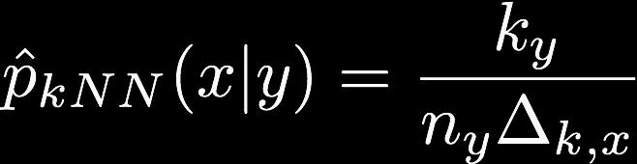
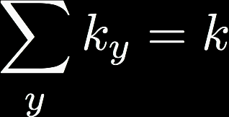
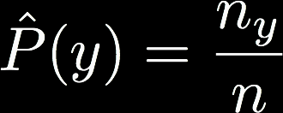
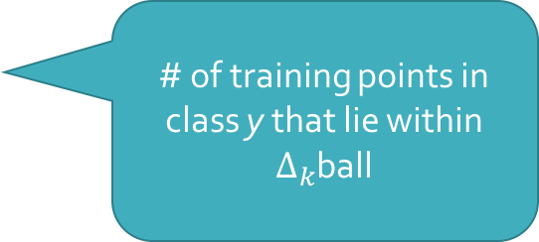
KNN Classification
Optimal classifier
KNN classifier
# of training points in class y
# of training points in class y that lie within $Δ_{k}$ball

Slide 23
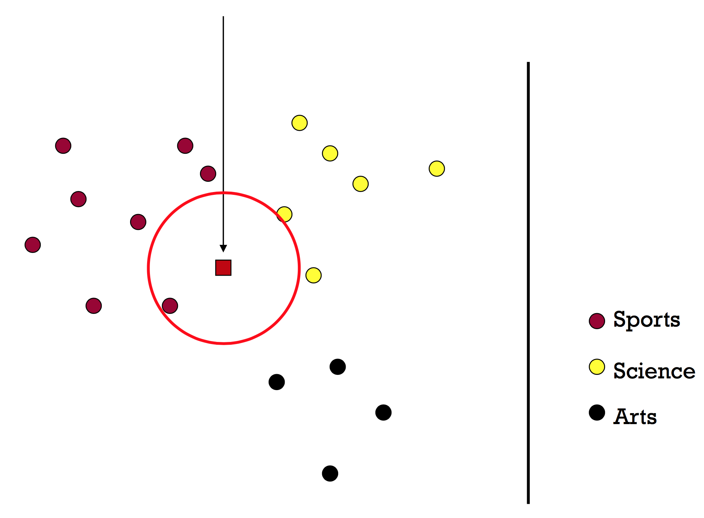
1-NN

Slide 24
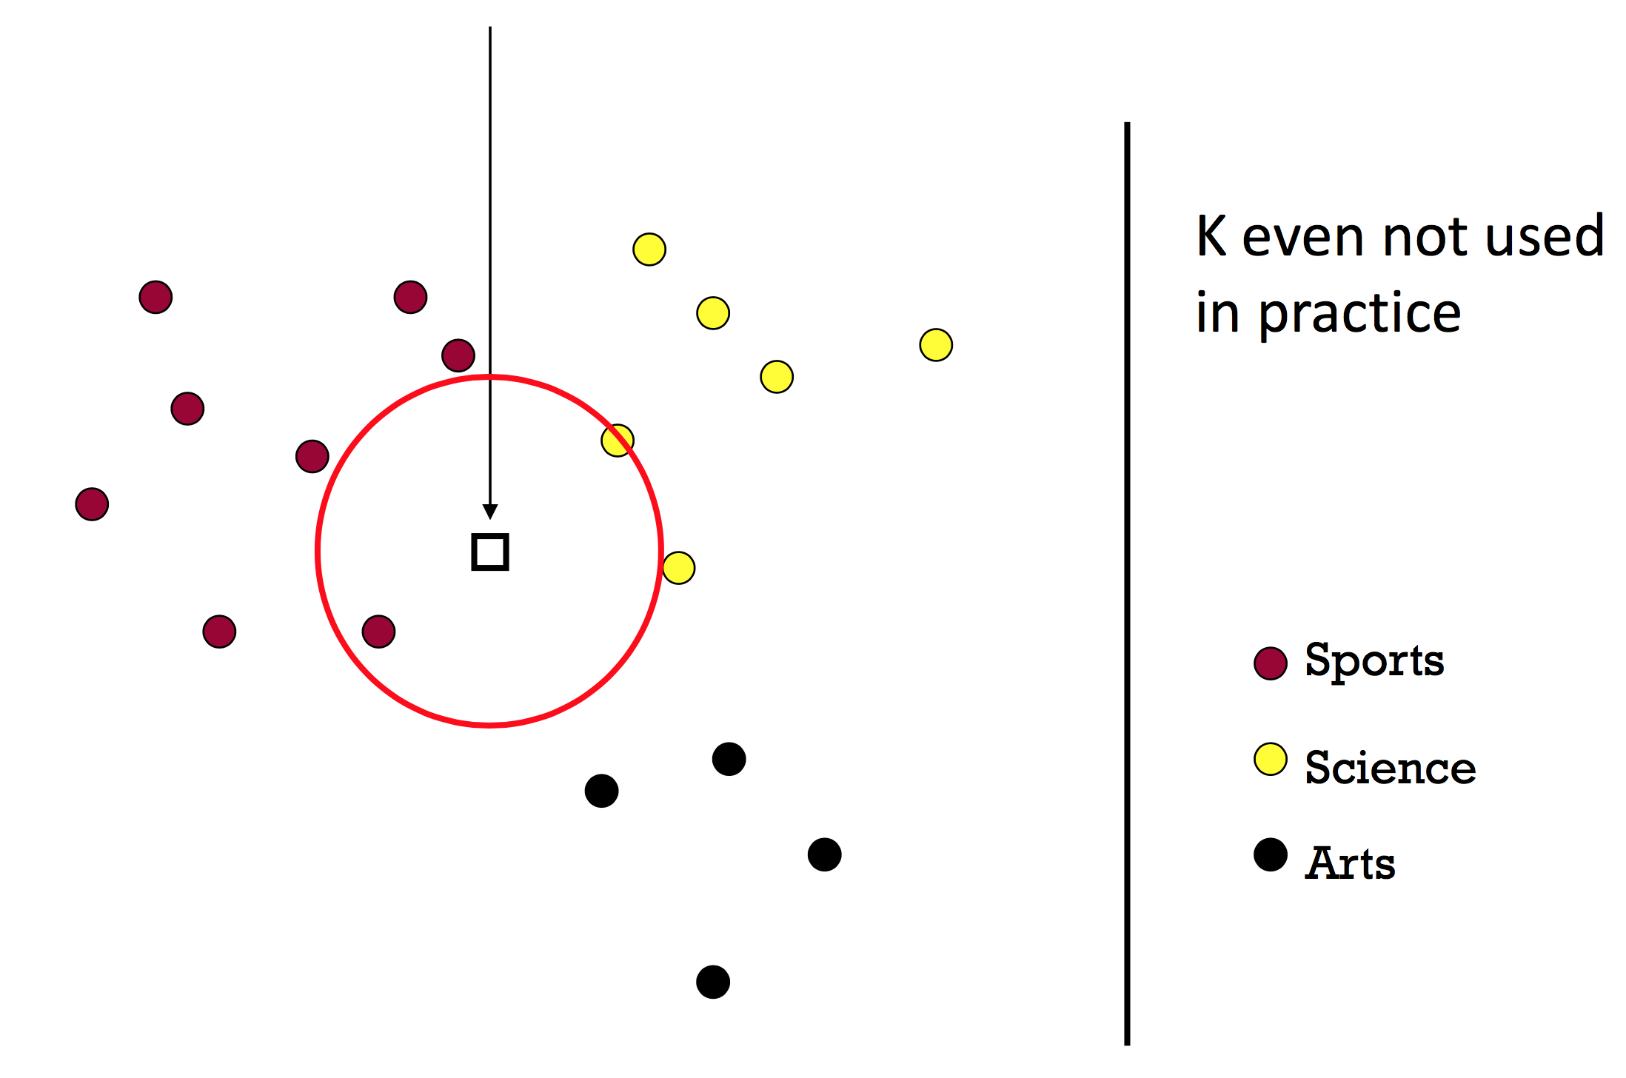
2-NN

Slide 25
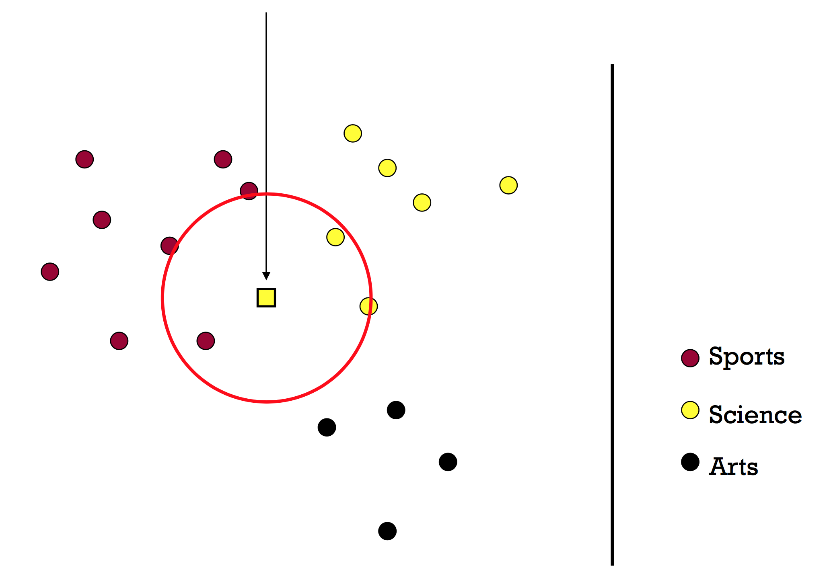
3-NN

Slide 26
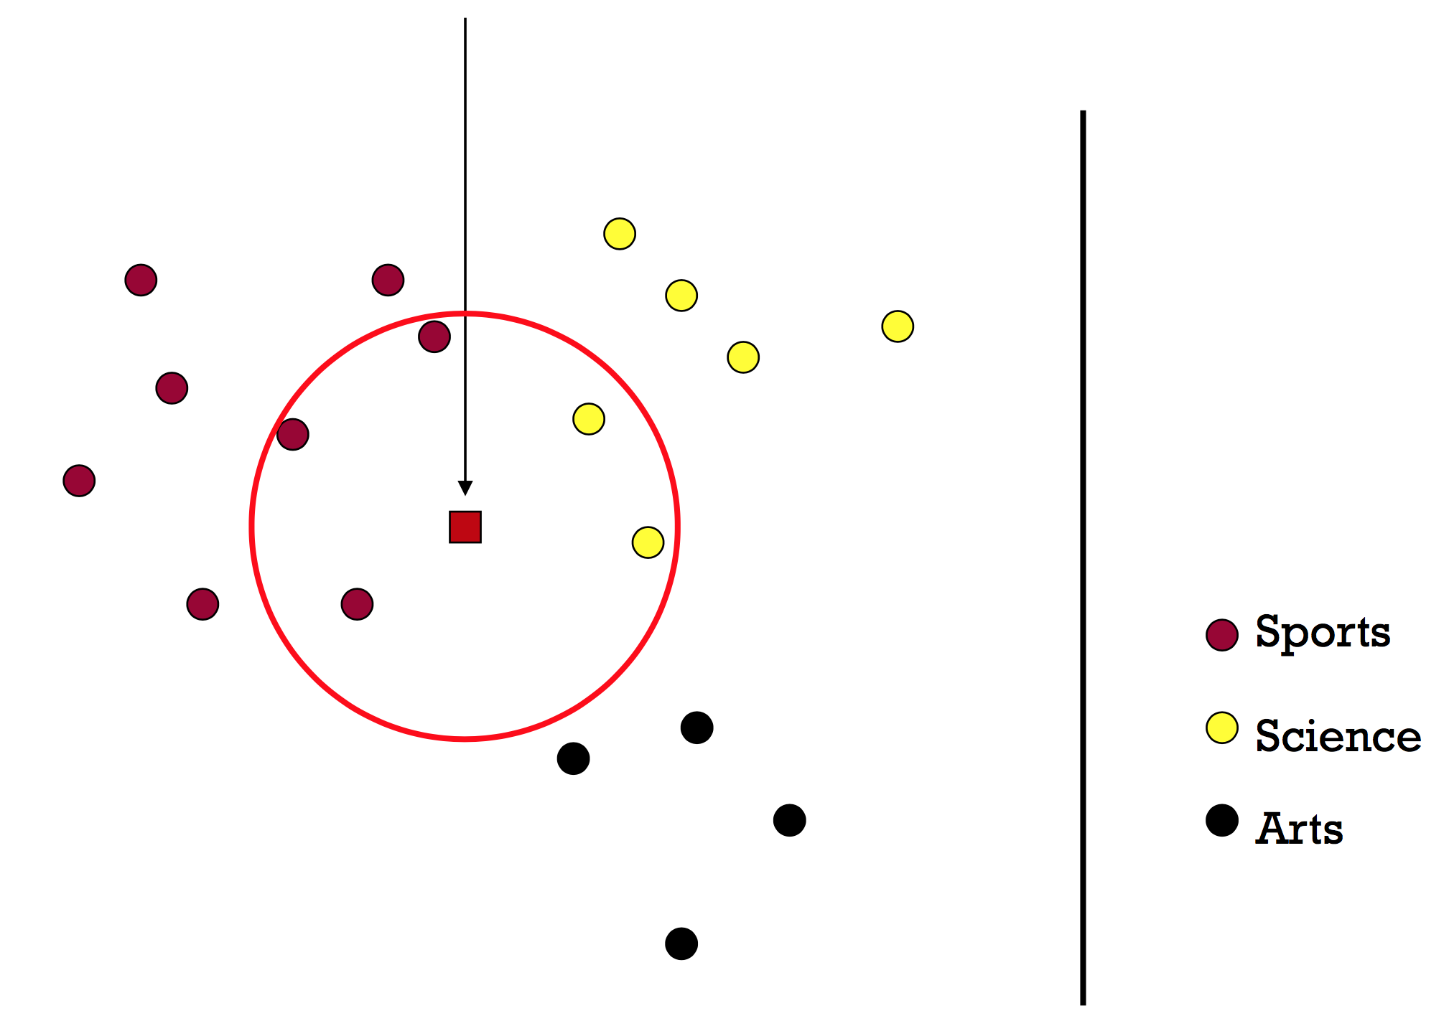
5-NN

Slide 27
What is the best k?
Bias-variance trade-off
Large k = predicted label is more stable
Small k = predicted label is more accurate
Similar to density estimation

Slide 28
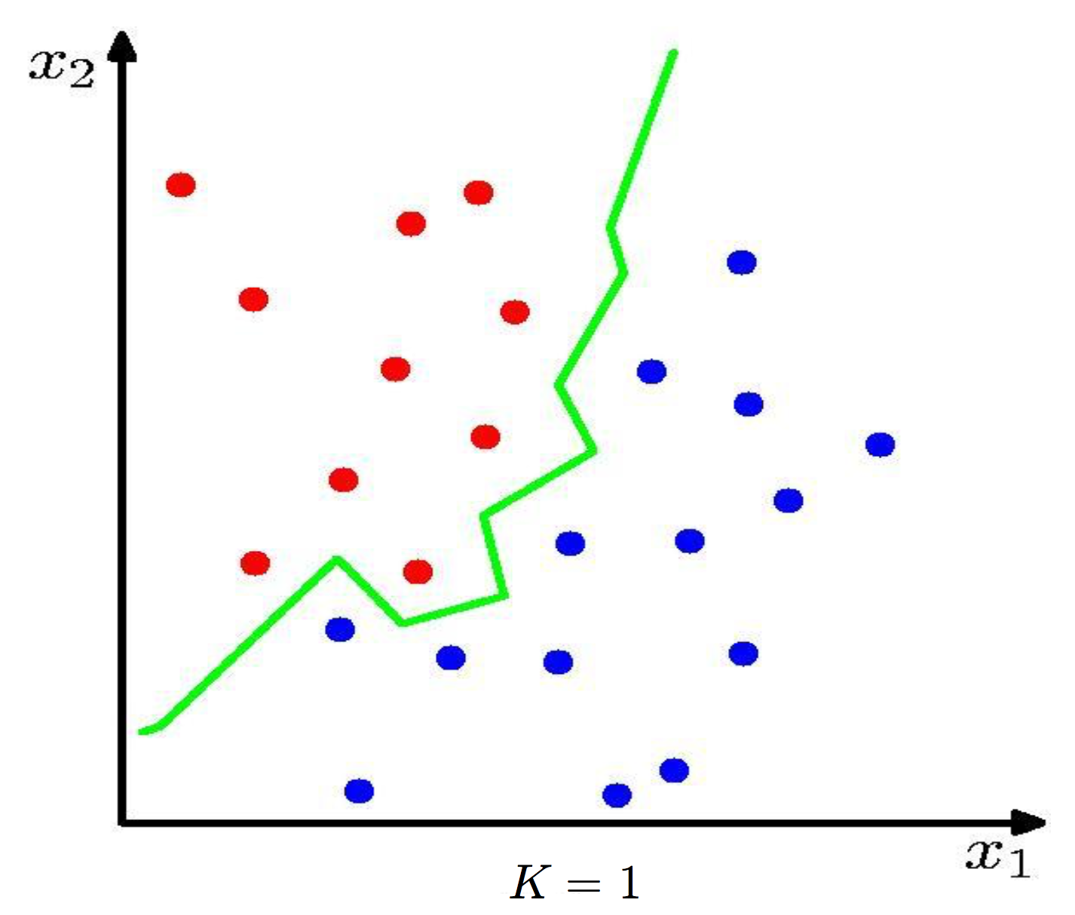
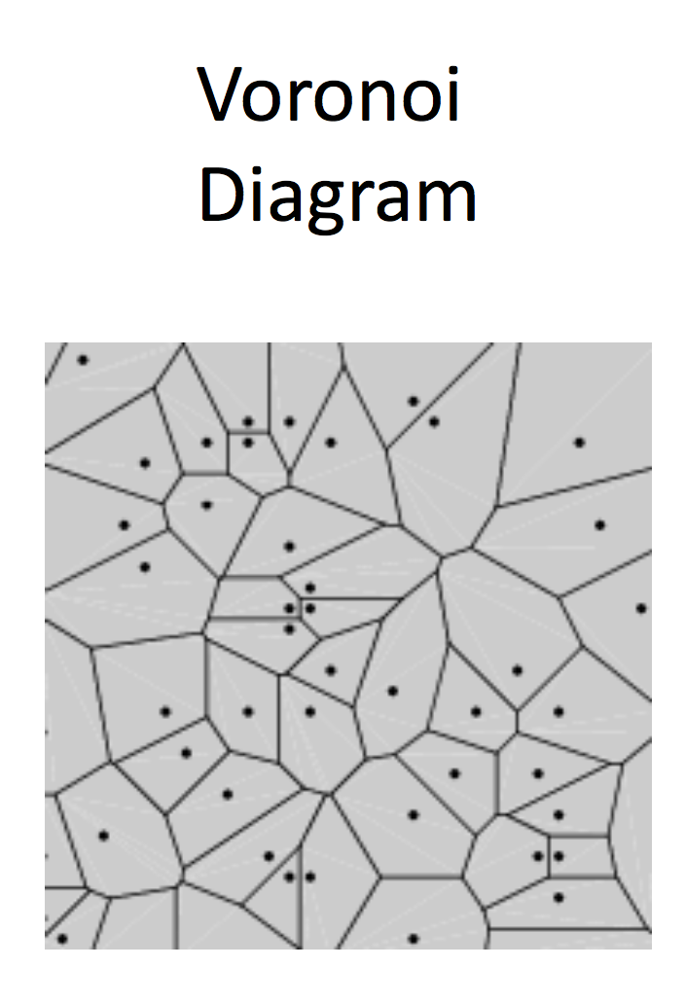
1-NN Decision Boundary

Slide 29
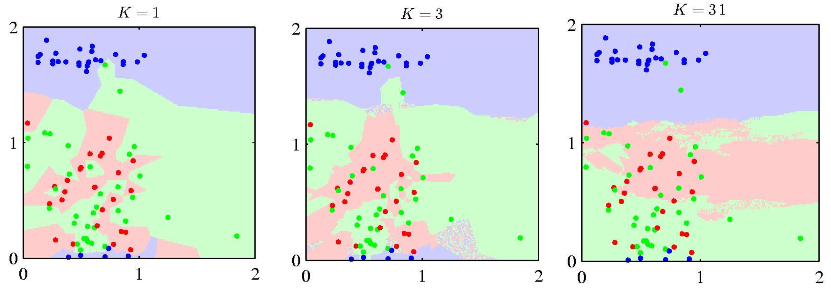
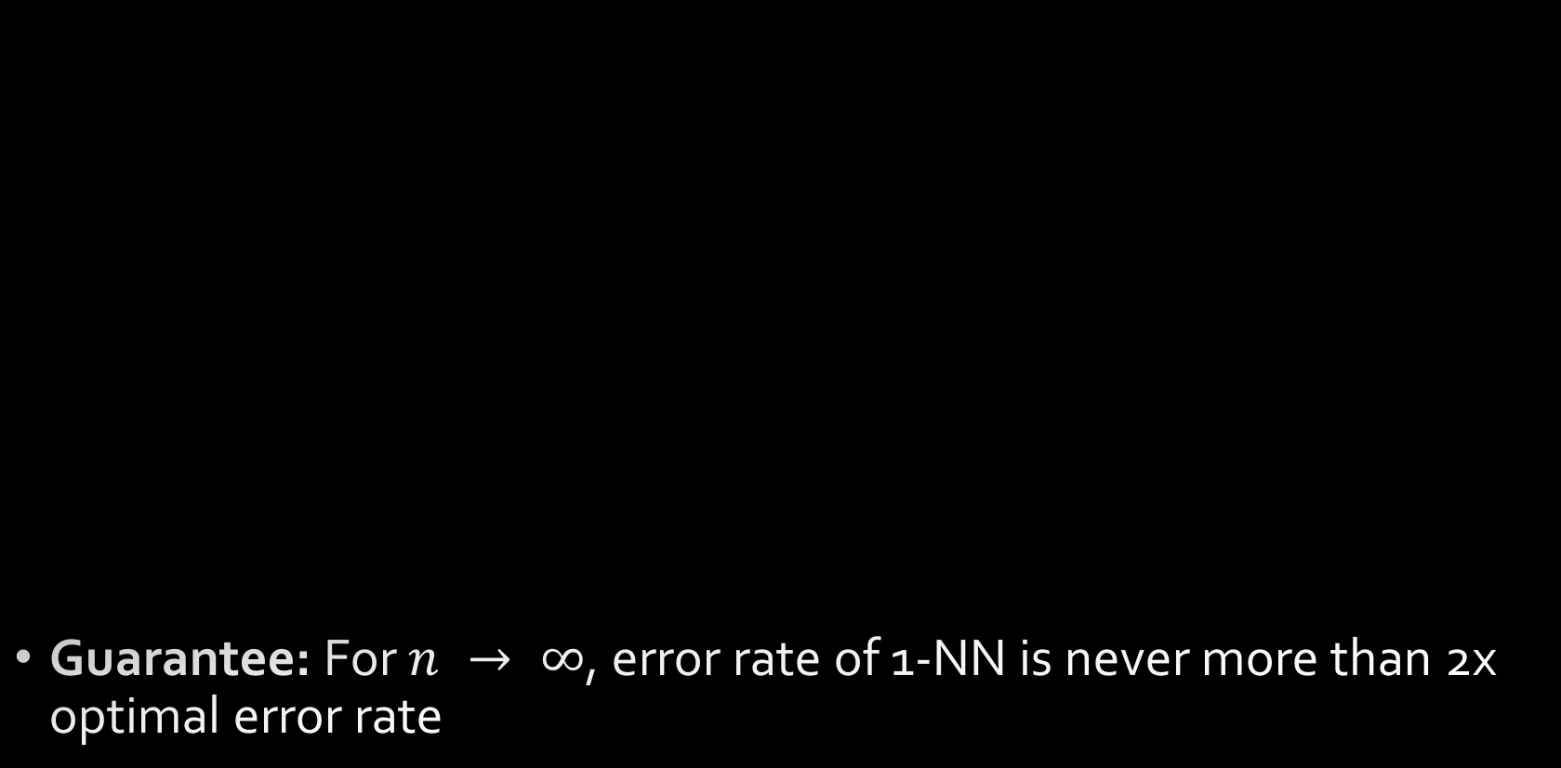
KNN Decision Boundaries
Guarantee: For $n → ∞$, error rate of 1-NN is never more than 2x optimal error rate

Slide 30
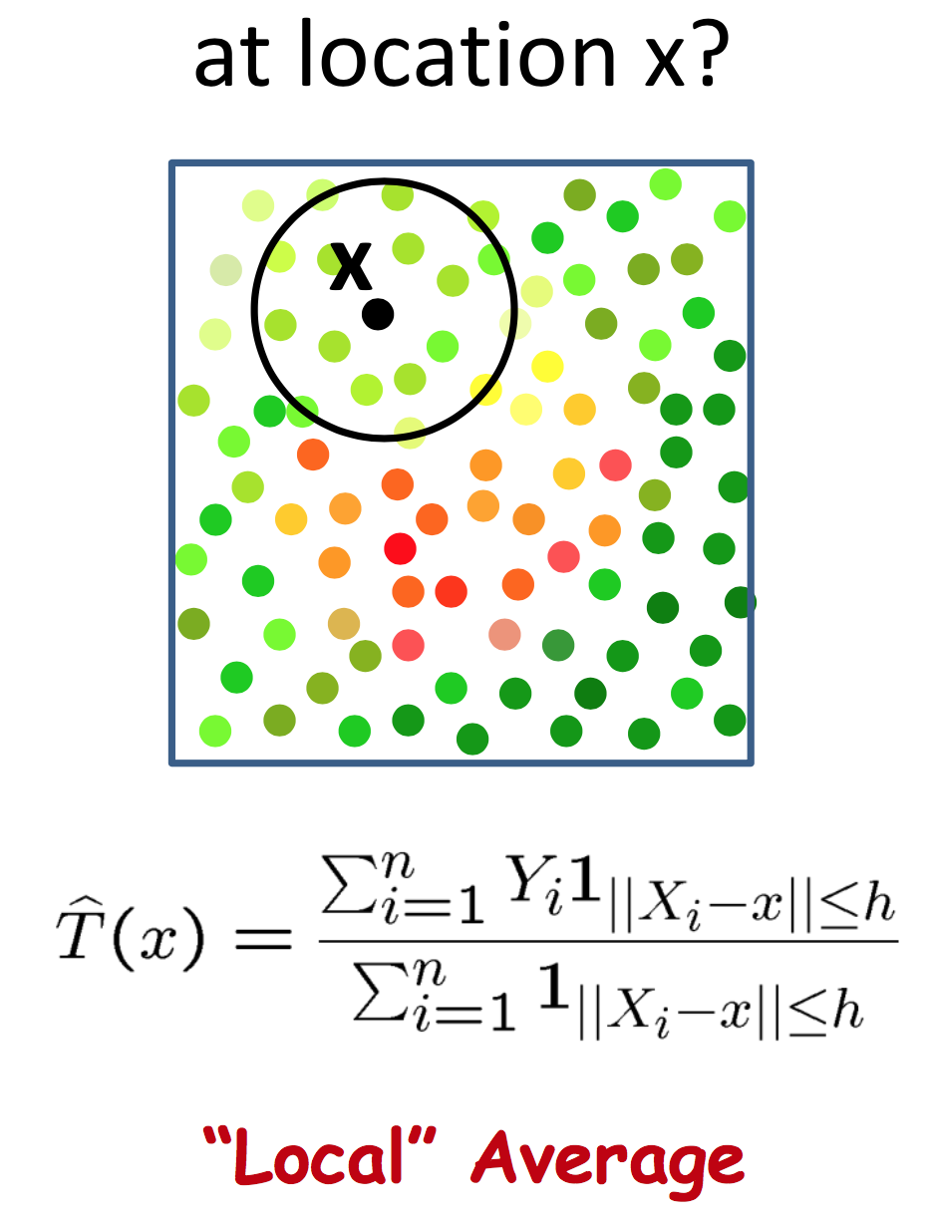

Temperature Sensing
What is the temperature in the room?

Slide 31



Kernel Regression
Or “local” regression
Nadaraya-Watson Kernel Estimator
Weight each training point on distance to test point
Boxcar kernel yields local average
…where

Slide 32

Choice of kernel bandwidth
Choice of kernel is not terribly important!

Slide 33



Kernel Regression as WLS
Weighted Least Squares (WLS) has the form
Compare to Nadaraya-Watson form
Kernel regression corresponds to locally constant estimator obtained from [locally] weighted least squares
Set where $β$ is constant

Slide 34



Kernel Regression as WLS
A constant value
Individual weights have to sum to 1

Slide 35


Support Vector Machines
Linear classifiers—which is better?
Pick the one with the largest margin

Slide 36




Support Vector Machines

Slide 37


Support Vector Machines
Maximize the margin
Distance of closest example / data point from the decision boundary / hyperplane:

Slide 38



Support Vector Machines
Rewrite the equation (drop a in favor of 1)
Solve via quadratic programming
Data points along margin = support vectors

Slide 39


SVMs
What if the data aren’t linearly separable?
Allow for “errors”
Maximize margin AND minimize mistakes
C: tradeoff parameter

Slide 40




SVMs
What if the data still aren’t linearly separable?
“Soft” margin
(penalize misclassified data by how far it is from the margin)
Misclassification penalty:
Recover “hard” margin:

Slide 41
SVMs are great, but…
Where is this going?
First, SVMs were the “big thing” right before deep learning
Neural network research had been dead for 10+ years
SVMs were showing immense promise, especially with high-dim data
Second, SVMs share a lot of theory with deep learning

Slide 42





Start with core parameterization of SVM
Write “primal” objective (Lagrange) function
Differentiate with respect to $β$, $β_{0}$, and $ζ_{i}$ and set to 0
Notes:
Beta = inverse of margin, so it’s a min (instead of max) problem
C = per-misclassification penalty
Zeta = slack weights per misclassification
Yi(x^Tbeta + beta0) >1 is the decision boundary
1 – zeta = allows for some points to be on the wrong side of the decision boundary
C = inf to reclaim hard boundary
Mu_i are lagrange variables
Alpha_i are lagrange variables

Slide 43



Substitute back into primal equation, and get the Lagrangian Dual
Notice anything?
Kernel!

Slide 44




Notes:
Solid line: decision boundary
Dotted lines: margins
Solid dots: support vectors

Slide 45
Summary
Nonparametric places mild assumptions on data; good models for complex data
Usually requires storing & computing with full dataset
Parametric models rely on very strong, simplistic assumptions
Once fitted, they are much more efficient with storage and computation
Effects of bin width & kernel bandwidth
Bias-variance trade-off
Kernel regression
Comparison to weighted least squares
Support Vector Machines
Powerful “shallow” models
Dual formulation of objective allows for kernel functions

Slide 46
Questions?

Slide 47
References
“All of Nonparametric Statistics”, http://www.stat.cmu.edu/~larry/all-of-nonpar/index.html

Slide 48
Other slides

Slide 49

Case Study: Newsgroups Classification
20 Newsgroups
61,118 words
18,774 documents
Class label descriptions

Slide 50

Case Study: Newsgroups Classification
Training/Testing
50%-50% randomly split
10 runs
Report average results
Evaluation Criteria

Slide 51

Case Study: Newsgroups Classification
Results in binary class comparisons

